Slide 1


INFO 1998: Introduction to Machine Learning
Notes:
https://www.polleverywhere.com/activities?folder=13675574

Slide 2
Lecture 3: Data Visualization
INFO 1998: Introduction to Machine Learning

Slide 3
Agenda
Why Data Visualization is Important
Data Visualization Libraries
Basic Visualizations
Advanced Visualizations
Challenges of Visualization

Slide 4
The Data Pipeline
Problem Statement
We are also here!
Summary and visualization
We are here!
Statistical and predictive results
Raw data
Usable data
Meaningful output
Data cleaning, imputation, normalization
Data analysis, predictive modeling, etc.
Solution
Debugging, improving models and analysis
https://towardsdatascience.com/5-steps-of-a-data-science-project-lifecycle-26c50372b492
Notes:
Data analysis; predictive modeling is rather straightforward;
Our visualizations will also help with the final summary, since it is nearly always necessary for the reader to understand what the data is before they read up on your models and other predictive results

Slide 5

Why is Data Visualization Important?
me
Raw CSV file
Data Visualization
Source

Slide 6
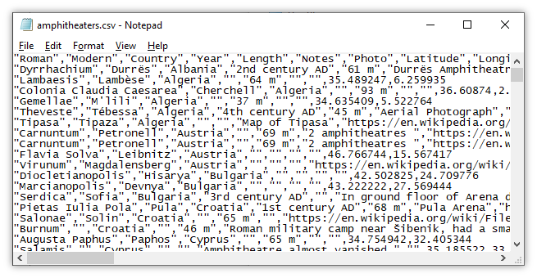
This!!!
https://manifold.net/doc/mfd9/images/eg_formats_csv01_01.png

Slide 7
Why is Data Visualization Important?
Informative
Appealing
Universal
Predictive

Slide 8
Why is Data Visualization Important?
Same summary stats (mean, median, mode) but different distributions!
We need to see how the actual data looks!
df.describe() is not enough
Source
Notes:
Stay here longer

Slide 9
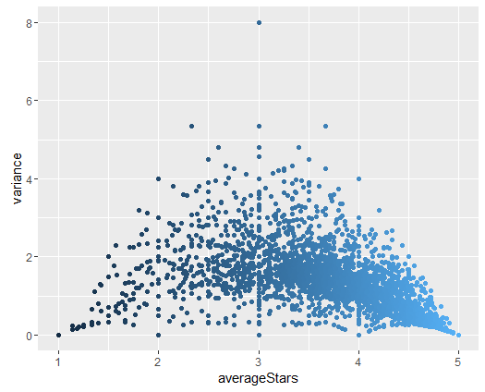
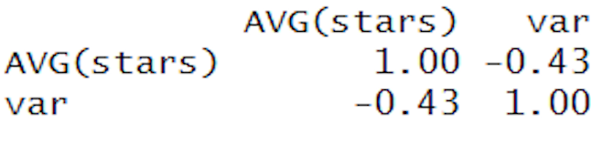
Data Visualization Simple Example: Ratings on Yelp
Question: What do you notice? What trends do you see?
Notes:
The variance goes down toward extreme
A lot of points that lie on the actual integer values
Heavier distribution over the right side of the plot (mean is greater than 3)
Points that are closer to 3 (tends to give 3 or 4)

Slide 10
Data Visualization Libraries
matplotlib
Python data visualization package
Capable of handling most data visualization needs
Simple object-oriented library inspired from MATLAB
Cheatsheet
seaborn
Another visualization package built on matplotlib
Notes:
ideas on the functioning of the heavenly nature, the essence of human nature and learning (self-cultivation), and how to motivate self-cultivation among the people.

Slide 11
Seaborn vs Matplot
Seaborn
Matplot
Easier syntax
Built for working with Pandas DF
High level functions for more robust visualizations
Superset of matplot
Syntactically more complex
Harder to work with for DF
Use for basic graphs
Python libraries for data visualizations!!

Slide 12
Basic Data Visualizations
Notes:
Uses rectangles of different height to represent magnitude or frequency
Ex. display the frequency of various responses to a survey question
Allows us to compare (categorical) features

Slide 13
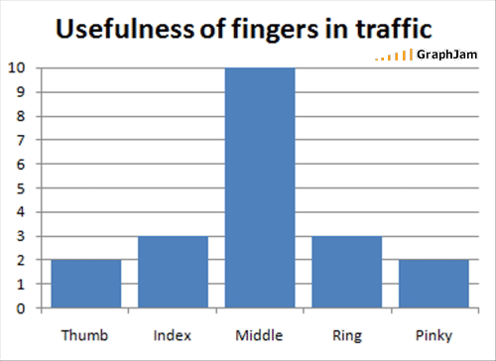
Bar Graph
Represent magnitude or frequency of discrete variables
Allows us to compare features
Source
Notes:
Uses rectangles of different height to represent magnitude or frequency
Ex. display the frequency of various responses to a survey question
Allows us to compare (categorical) features

Slide 14
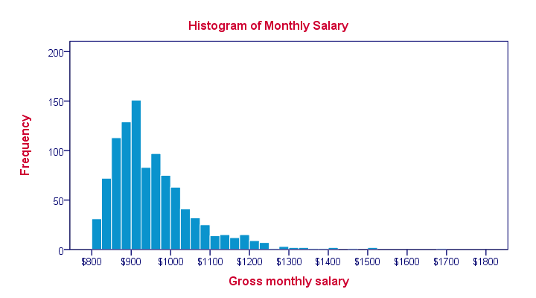
Histograms
Used to observe frequency distribution of continuous variables
Data split into bins
Source
Notes:
Used to observe frequency distribution of numerical data
Ex. exam scores, height
We can choose number and size of bins

Slide 15
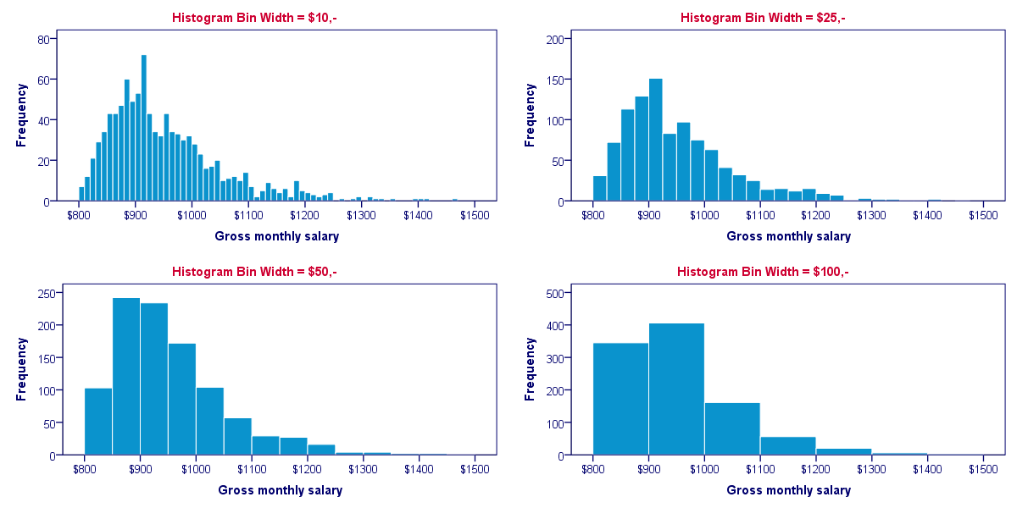
Histograms: Different Bin Sizes
Source
Notes:
Used to observe frequency distribution of numerical data
Ex. exam scores, height
We can choose number and size of bins

Slide 16
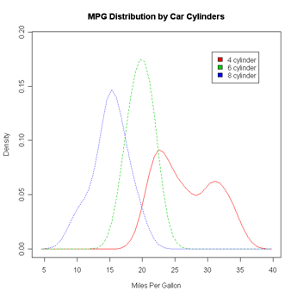
Density Plot
Like a histogram, but smooths the shape of the distribution
Source
Notes:
Like a histogram, but uses kernel smoothing to display the shape of the distribution
Peaks show areas of highest concentration in data
Why is Density Plot important?

Slide 17
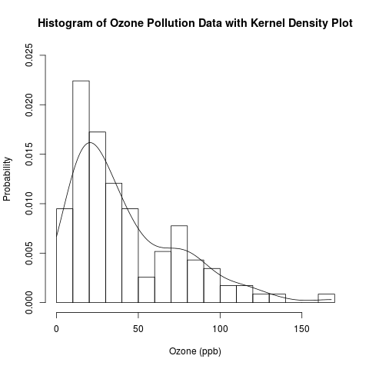
Histogram vs Density Plot
Source
Notes:
Histogram shape varies with bin size
Density plot often captures overall trend better
The “smoothing” of density plot can remove some important details

Slide 18
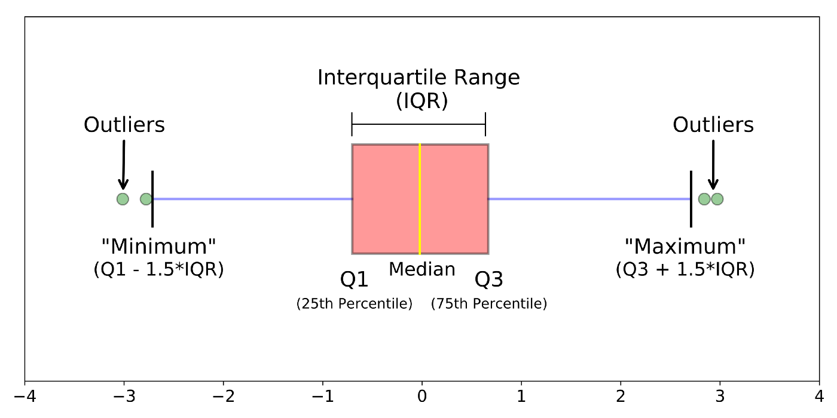
Boxplot (a.k.a box and whisker plot)
Summary of data
Shows spread of data
Gives range, interquartile range, median, and outlier information
Source
Notes:
Shows spread of data
Good for quickly summarizing
Ex. test scores

Slide 19
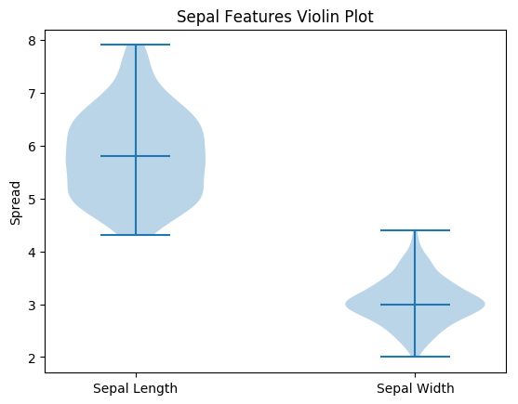
Violin Plot
Combination of boxplot and density plot to show the spread and shape of the data
Can show whether the data is normal (i.e. is distributed normally)
Notes:
Combination of boxplot and density plot to show the spread and shape of the data
Best of both worlds!
Ex. number of customers by time of day
Can show whether the data is normal

Slide 20
Advanced Data Visualizations
Notes:
Uses rectangles of different height to represent magnitude or frequency
Ex. display the frequency of various responses to a survey question
Allows us to compare (categorical) features

Slide 21
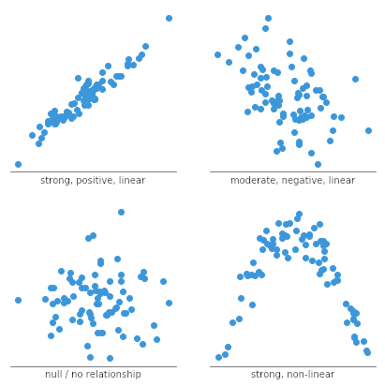
Scatterplot
See relationship between two features
Can be useful for extrapolating information
https://chartio.com/learn/charts/what-is-a-scatter-plot/
Notes:
Scatter plots are also known as scatter charts or scatter graphs. It uses dots to represent values for two different variables. The horizontal and vertical axis indicates these values, and it allows us to see the relationship between two features. For example, the correlation between height and weight.
Can be useful for extrapolating information
All data points are visible

Slide 22
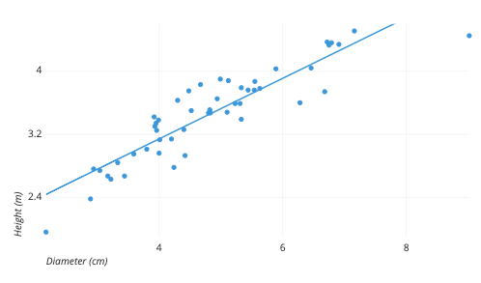
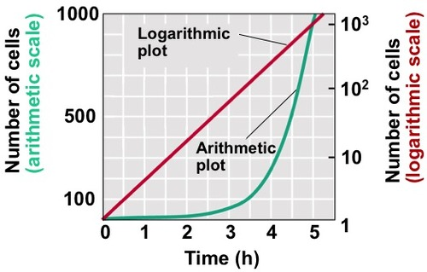
Scatterplot – more ways
Line of best fit
Notes:
Logarithm
axis scaling
Model results can be layered
Line of best fit
Use different shapes or colors for clusters
bubble chart
larger points indicate higher values
Showing count of same point through different size

Slide 23
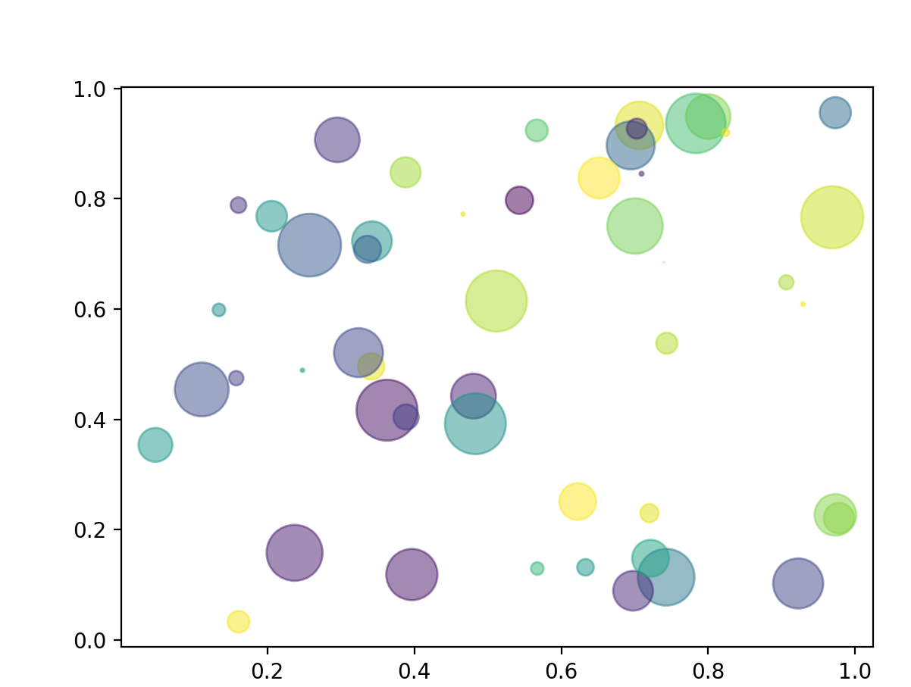
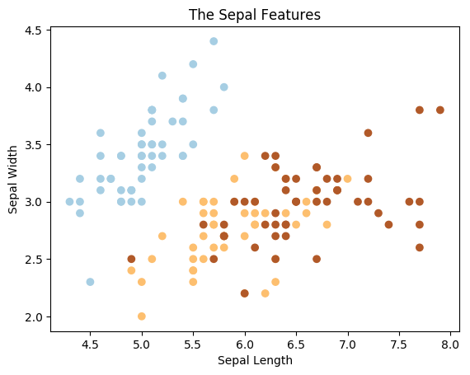
Scatterplot – more ways
Line of best fit
Demonstrate clusters
Bubble chart
Notes:
GDP with some small values
Logarithm
axis scaling
Model results can be layered
Line of best fit
Use different shapes or colors for clusters
bubble chart
larger points indicate higher values
Showing count of same point through different size

Slide 24
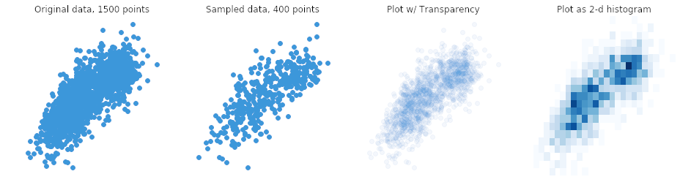
Scatterplot - Overplotting
Only sample a random selection
Change dot form (eg. add transparency)
Use heatmap
https://chartio.com/learn/charts/what-is-a-scatter-plot/
Notes:
When we have lots of data points to plot, we may face the issue of overplotting. This is when data points overlap to an extent that it’s difficult for us to see the relationship between points and variables.
How to deal with this issue? One option is to sample only a subset of data points, since a random selection of points should still give the general idea of the patterns in the full data.
The second option is to change the form of the dots, such as making them more transparent so that overlaps are visable.
Or, we can choose a different chart type like the heatmap, where color indicates the number of points in each bin.

Slide 25
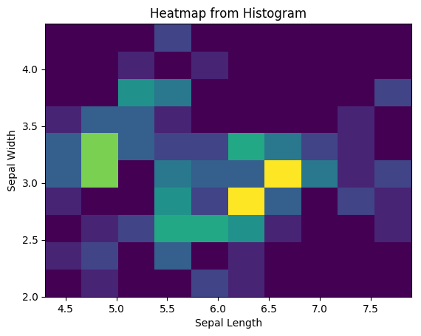
Heatmap
Varying degrees of one metric are represented using color
Especially useful in the context of maps to show geographical variation
Notes:
2-D histogram
Commonly applied for describing the density or intensity of variables, visualize patterns, and anomalies.
Varying degrees of one metric are represented using color¹
Uses color to display change in a variable with respect to other variables
Ex. click density on a website
Can be especially useful in the context of maps to show geographical variation

Slide 26
Heatmap - Click Density / Website Heatmaps
Notes:
Varying degrees of one metric are represented using color¹
Uses color to display change in a variable with respect to other variables
Ex. click density on a website
Can be especially useful in the context of maps to show geographical variation

Slide 27
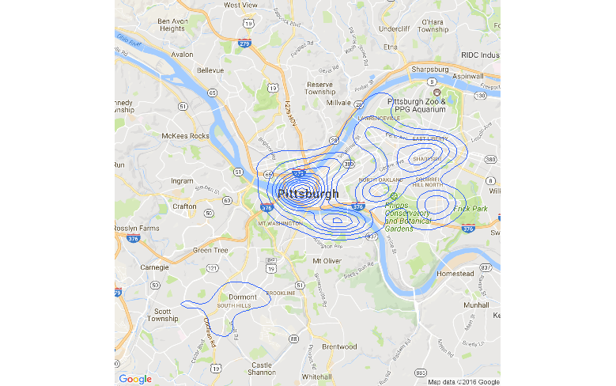
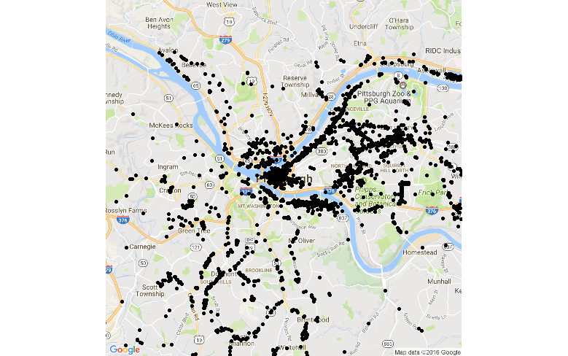
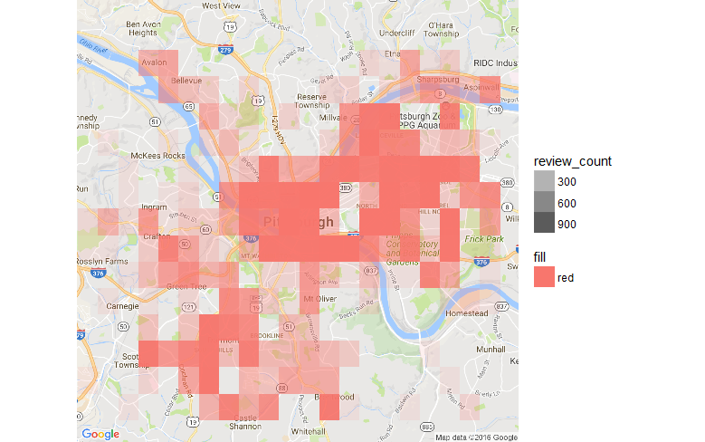
Using Maps
Map visualization → contextual information
Trends are not always apparent in the data itself
Eg. Longitudes + Latitudes → Geographical Map
Notes:
Population density (like contour map). Car crashes

Slide 28
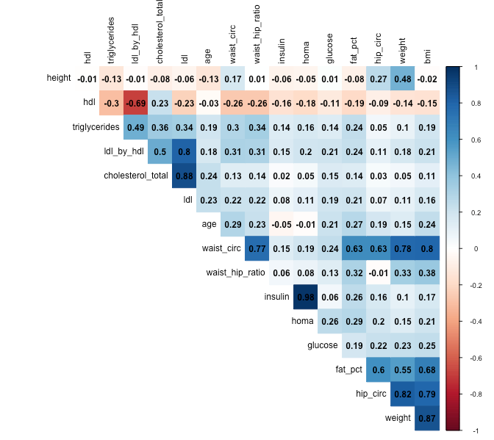
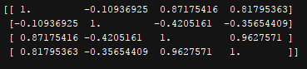
Correlation Plots
2D matrix with all variables on each axis
Entries represent the correlation coefficients between each pair of variables
Why are all entries on the diagonal ‘1’?
Source
Notes:
2D matrix with all variables in the dataset on each axis
Entries represent the correlation coefficients between each pair of variables
All entries on the diagonal are 1 (question: can anyone explain why?) and the matrix is symmetric

Slide 29
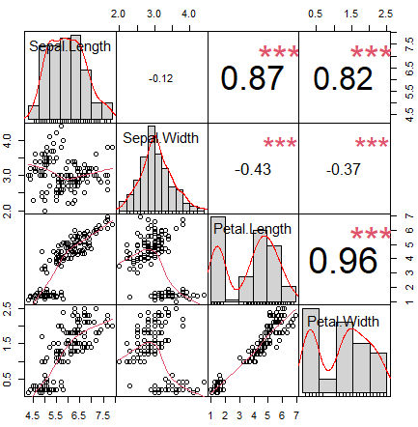
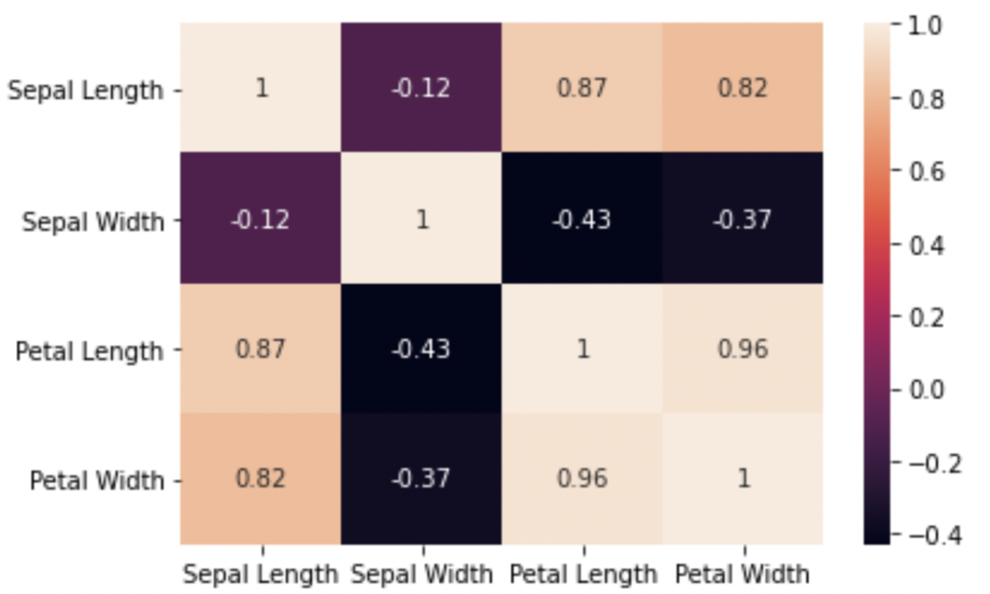
Correlation Plots
https://r-coder.com/correlation-plot-r/
Notes:
To understand the correlation plots better, we can see an example from our iris dataset.
We will see this in our demo later.

Slide 30
Demo

Slide 31
Challenges of Visualization
Higher Dimension
Non-Trivial
Time Consuming
Hard to Show Uncertainty
Notes:
High dimensions
Difficult to represent data over 3-dimensions
Learn about visualizing more complex data: readme
Finding the right visualization for a given dataset is a nontrivial task
May be time-consuming and impedes production process
Can be difficult to show uncertainty of data

Slide 32
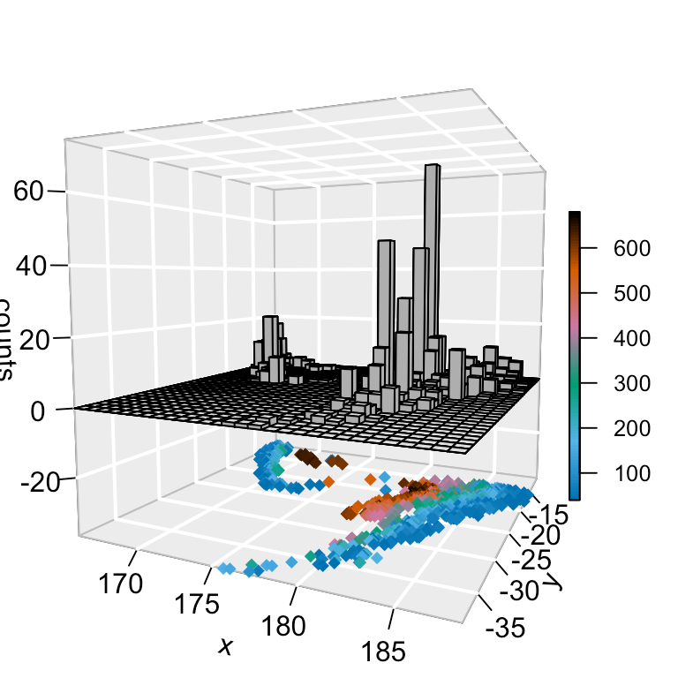
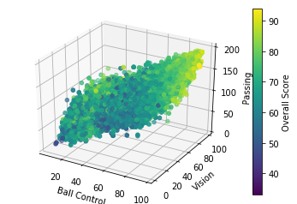
High Dimensional Data
Color, time animations, or point shape can be used for higher dimensions
There is a limit to the number of features that can be displayed
4D Plot For Earthquake Data
Notes:
Color, time animations, or point shape can be used for higher dimensions
Can reveal trends that were masked previously
Graphs have limited space, select the most important features to display
https://matplotlib.org/stable/gallery/index.html
Left: Count and depth of seismic events
Right: Basket ball rating players

Slide 33
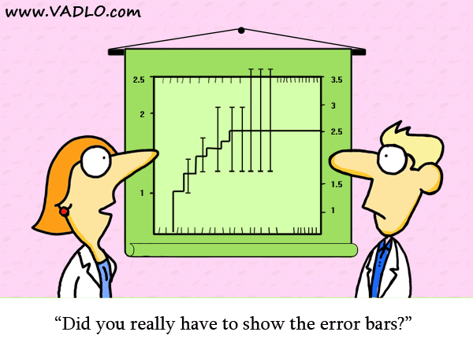
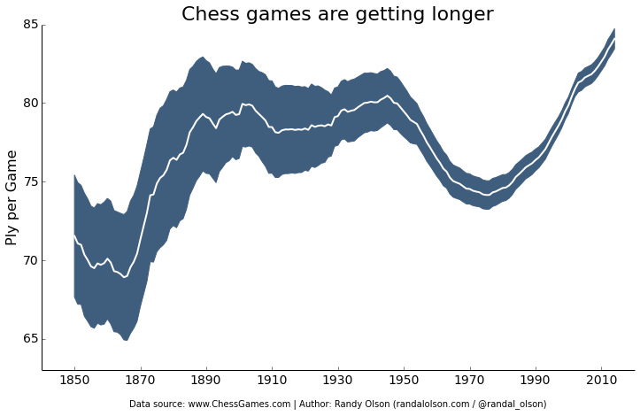
Error Bars
Show uncertainty
Usually display 95 percent confidence interval
Notes:
They take on different looks
You will learn about how to make error bars in your homework

Slide 34
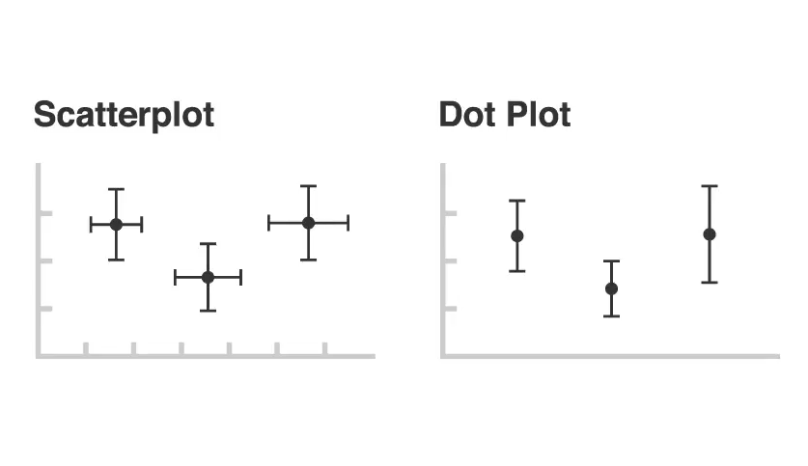
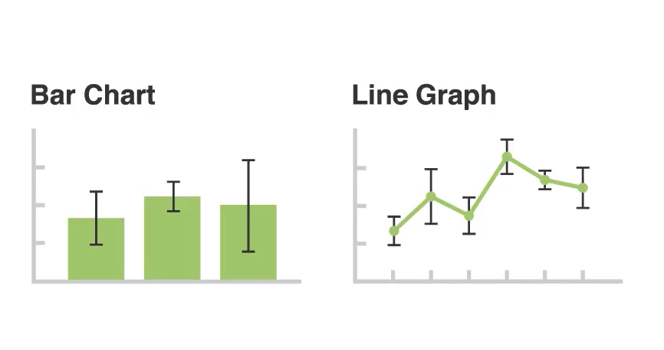
Error Bars
https://www.geeksforgeeks.org/errorbar-graph-in-python-using-matplotlib/
Notes:
Can add to any other to graph
Depends on which scale is quantitative for the orientation

Slide 35
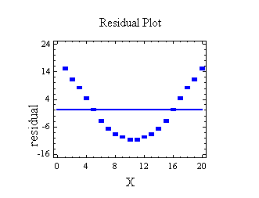
Residual Plot
Values should be equally and randomly spaced on horizontal axis
Regression line is called line of best fit
Not optimal if data has outliers or is non-linear
Notes:
Can add to any other to graph
Depends on which scale is quantitative for the orientation

Slide 36
Projects!
For your visualizations..
Choose the proper visualization
Don’t forget title, axis titles, etc.
2-3 people per project!
Come up to the front to find someone
Partner finding on ED!

Slide 37
Coming Up
Assignment 3: Due next Wednesday at 11:59 PM
Next Lecture: Fundamentals of Machine Learning
Check ED before writing emails! Post Questions on ED!

